Slide 1
STANAG 4586 Literature Review Overview
Christopher Lum PhD lum@uw.edu
Kevin Ueunten, Master Student kueunten@gmail.com
January 17, 2014

Slide 2
STANAG Levels
Level 1: “Indirect receipt/transmission of UAV related data and metadata”
You gather information about the UAV via radar or other sensors
Level 2: “Direct receipt / transmission of UAV related data and metadata”
Other UAV provides you information on itself
Level 3: “Control and monitoring of the UAV payload, not the unit”
You control only the payload but you do not fly the UAV
Level 4: “Control and monitoring of the UAV without launch and recovery”
You only fly the UAV but do not take off or land
Level 5: “Control and monitoring of the UAV including launch and recovery”
You control the UAV from takeoff and landing
*Quotes are directly from Lockheed Martin’s website
**A UAV may have multiple levels
For ex: if you fly the UAV and control the payload you have level 3 and level 4

Slide 3
STANAG Messages Useful for CAPlugin
These two STANAG Messages are the most useful for the CAPlugin:
STANAG Message #101: Inertial state (allowable max latency 1,000 msec)
STANAG Message #110: From waypoint to next waypoint (allowable max latency 2,000 msec)
These two messages are vital for the plugin because they provide information on the following:
UAV’s position
UAV’s speed
UAV’s acceleration
UAV’s previous waypoint
UAV’s current waypoint
UAV’s next waypoint

Slide 4
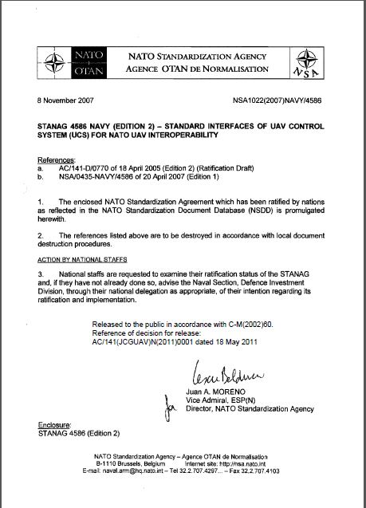
Useful Resource: STANAG 4586
Go to the following URL, for a copy of STANAG 4586:
http://nsa.nato.int/nsa/zPublic/stanags/current/4586eed02a2.pdf

